Slide 1
CSE424
PANNs: Large-Scale Pretrained Audio Neural Networks for Audio Pattern Recognition

Slide 2
Audio pattern recognition is an important research topic in the machine learning area, and includes several tasks such as audio tagging, acoustic scene classification, music classification, speech emotion classification and sound event detection.
In this paper, a pretrained audio neural networks (PANNs) trained on the large-scale AudioSet dataset has been proposed.

Slide 3
INTRODUCTION
Audio pattern recognition is an important research topic in the machine learning area, and plays an important role in our life.
Audio pattern recognition contains several tasks such as audio tagging, acoustic scene classification, music classification, speech emotion classification and sound event detection.
Hidden Markov model (HMM);
Recently, the Detection and Classification of Acoustic Scenes and Events (DCASE) challenge series have provided publicly available datasets
A milestone for audio pattern recognition was the release of AudioSet, a dataset containing over 5,000 hours of audio recordings with 527 sound classes.
In this paper, A pretrained audio neural networks (PANNs) has been proposed which is trained on raw AudioSet recordings with a wide range of neural networks.

Slide 4
AUDIO TAGGING SYSTEMS
Audio tagging is an essential task of audio pattern recognition, with the goal of predicting the presence or absence of audio tags in an audio clip.
CNNs: CNNs have been successfully applied to computer vision tasks such as image classification.Short time Fourier transforms (STFTs) are applied. The PANNs use are based on our previously-proposed cross-task CNN systems for the DCASE 2019 challenge, with an extra fully-connected layer added to the penultimate layer of CNNs.
Adapting ResNets for Audio tagging: Deeper CNNs have been shown to achieve better performance than shallower CNNs for audio classifications and ResNet was adapted for Audio tagging.
MobileNets : Computational complexity is an important issue when systems are implemented on portable device and it is also adapted for audio tagging.
One-dimensional CNNs: To improve performance, several researchers proposed to build one-dimensional CNNs which operate directly on the time-domain waveform and for this DaiNet, LeeNet has been used in this paper.

Slide 5
WAVEGRAM-CNN SYSTEMS
The Wavegram-CNN is a time-domain audio tagging system.
A Wavegram is designed to learn a time frequency representation that is a modifcation of the Fourier transform
A Wavegram is designed to learn frequency information that may be lacking in one-dimensional CNN systems.
To build a Wavegram, first apply a one-dimensional CNN to time-domain waveform.
The Wavegram learns frequency information by introducing F frequency bins in each of C/F channels.
Two dimensional CNNs such as CNN14 can capture time-frequency invariant patterns on the Wavegram.

Slide 6
Wavegram-Logmel-CNN
we can combine the Wavegram and log mel spectrogram into a new representation.
The combination is carried out along the channel dimension.

Slide 7
DATA PROCESSING In this section, we introduce data processing for AudioSet tagging, including data balancing and data augmentation.
A. Data balancing:
The number of audio clips available for training varies from sound class to sound class.
Training data are input to a PANN in mini-batches during training.
Without a data balancing strategy, audio clips are uniformly sampled from AudioSet.
To solve this problem, have to design a balanced sampling strategy to train PANNs.

Slide 8
B. Data augmentation:
Data augmentation is a useful way to prevent a system from overfitting.
Mixup is a way to augment a dataset by interpolating both the input and target of two audio clips from a dataset.
SpecAugment was proposed for augmenting speech data for speech recognition.
Frequency masking is applied such that f consecutive mel frequency bins [f0, f0+f] are masked.
The frequency mask can improve the robustness of PANNs to frequency distortion of audio clips

Slide 9

Finding the performance of PANN on AudioSet tagging
PANNs are transferred to several audio pattern recognition tasks, including acoustic scene classification, general audio tagging, music classification and speech emotion classification.

Slide 10
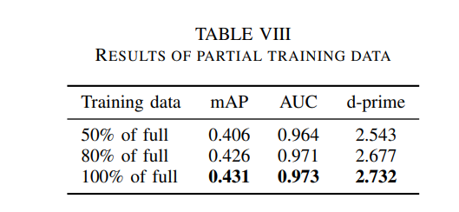
Dataset & Training
AudioSet dataset is used which is extracted from YouTube.
The training set consists of 2,063,839 audio clips.
Using 18,887 audio clips of the evaluation dataset.
They clip 10 seconds and convert it to 32Khz.
STFT is applied on the waveforms with a Hamming window of size 1024 and a hop size of 320 samples.
The torchlibrosa1 , a PyTorch implementation of functions of librosa to build log mel spectrogram extraction into PANNs. The log mel spectrogram of a 10-second audio clip has a shape of 1001 × 64.
A batch size of 32, and an Adam optimizer with a learning rate of 0.001 is used for training

Slide 11
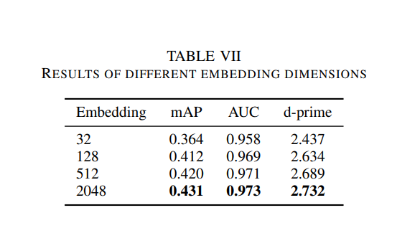

Slide 12
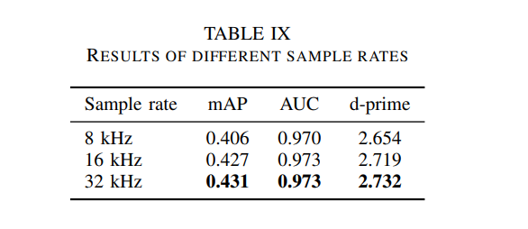

Slide 13
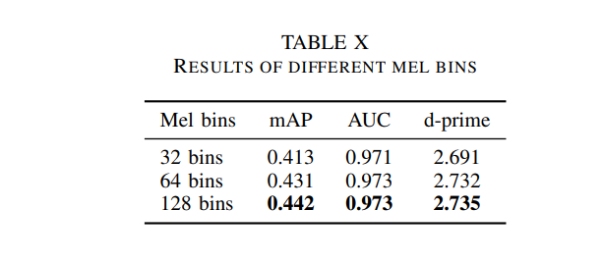

Slide 14
Results
RESULTS WITH DATA BALANCING AND AUGMENTATION
RESULTS OF DIFFERENT HOP SIZES
RESULTS OF DIFFERENT EMBEDDING DIMENSIONS
RESULTS OF PARTIAL TRAINING DATA
RESULTS OF DIFFERENT SAMPLE RATES
RESULTS OF DIFFERENT MEL BINS
RESULTS OF DIFFERENT SYSTEMS

Slide 15
Discussion
PANNs can be used as a pretrained model for new audio pattern recognition tasks.
PANNs have been successful in generalizing to other audio pattern recognition tasks with limited number of training data.

Slide 16
conclusion
Wavegram feature learnt from waveform
Wavegram-Logmel-CNN that achieves stateof-the-art performance in AudioSet tagging
Extend PANNs to more audio pattern recognition tasks

Slide 17
Thank You

